Slide 1
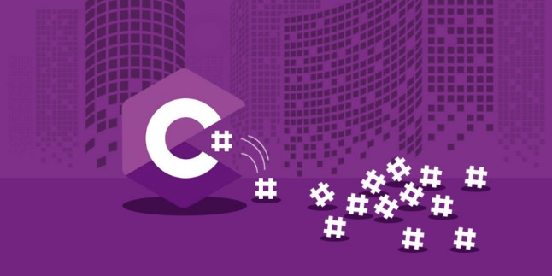
C# Basics

Slide 2
Introduction to C# and .NET
C# is designed by Anders Hejlsberg from Microsoft in 2000
C# is general purpose programming language
C# is object oriented (class-based) programming language
C# is used on .NET platform /.NET 6 is the latest version/
C# can be used for writing of Console, Desktop, Widows Services, Web apps, Mobile apps, Games and IoT
C# supports static typing, functional programming, generics and more features
C# and Microsoft documentation are generally quite good
C# documentation: https://docs.microsoft.com/en-us/dotnet/csharp/

Slide 3

Anders Hejlsberg
Danish software engineer who co-designed several programming languages and development tools. He is the original author of Turbo Pascal and co-chief of Delphi. Currently works in Microsoft as a lead architect and core developer of TypeScript.

Slide 4
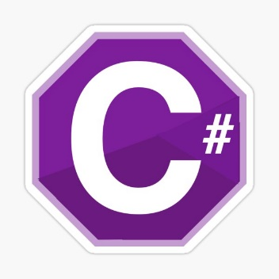


What is .NET?
.NET is a free, cross-platform, open source developer platform for building many different types of applications.
With .NET, you can use multiple languages, editors, and libraries to build for web, mobile, desktop, games, and IoT.
The two main components of .NET are CoreCLR and CoreFX
You can write on C#, F#, Visual Basic and other programming languages.

Slide 5

.NET = The Ecosystem
Languages
Runtimes
Libraries

Slide 6
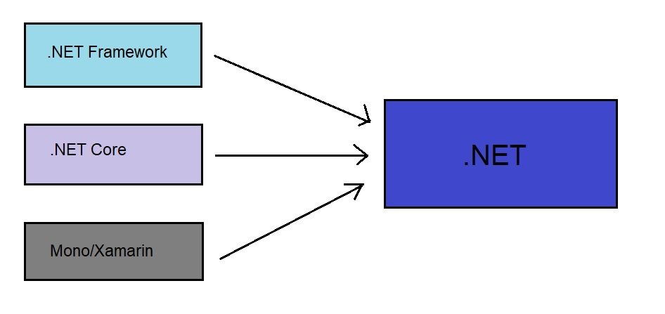
.NET ecosystem

Slide 7
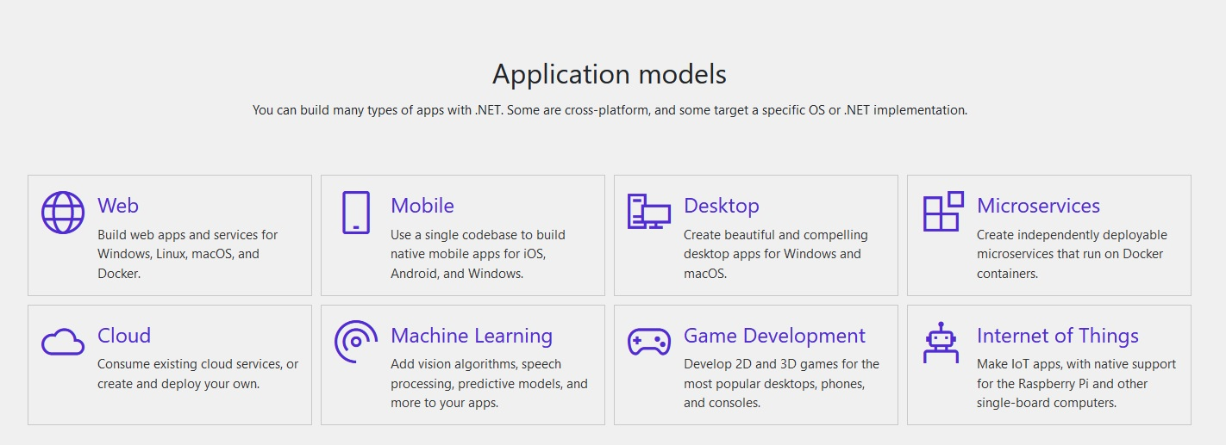
.NET platform /whole new world/

Slide 8
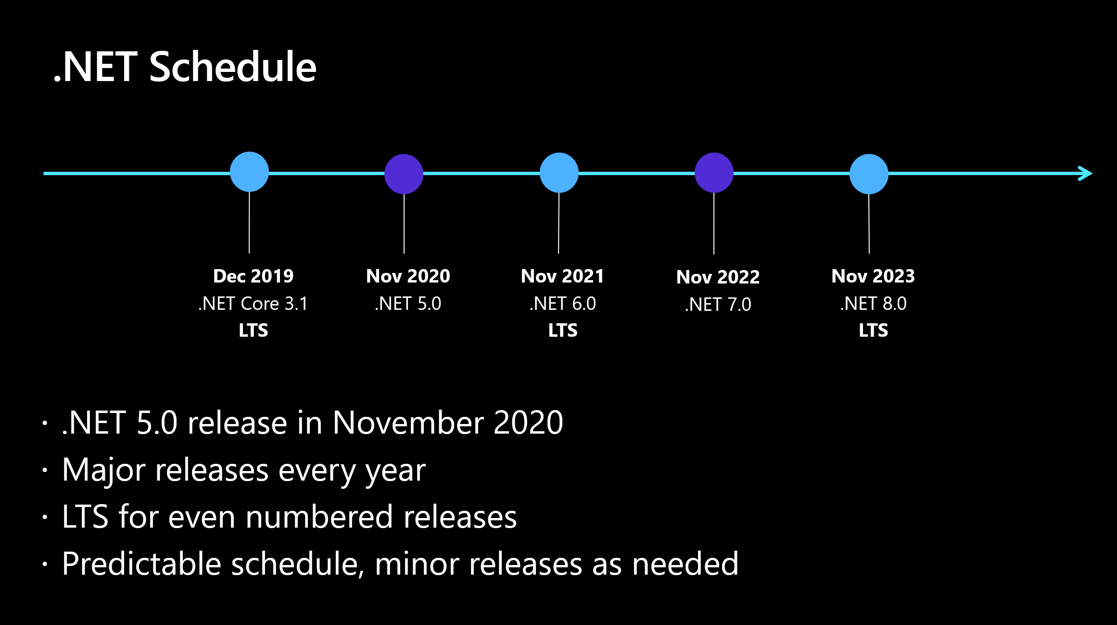
.NET Schedule

Slide 9
What is compiler?
A compiler is a special program that translates a programming language's source code into machine code, bytecode or another programming language. The source code is typically written in a high-level, human-readable language such as C#, Java, C++, etc.

Slide 10
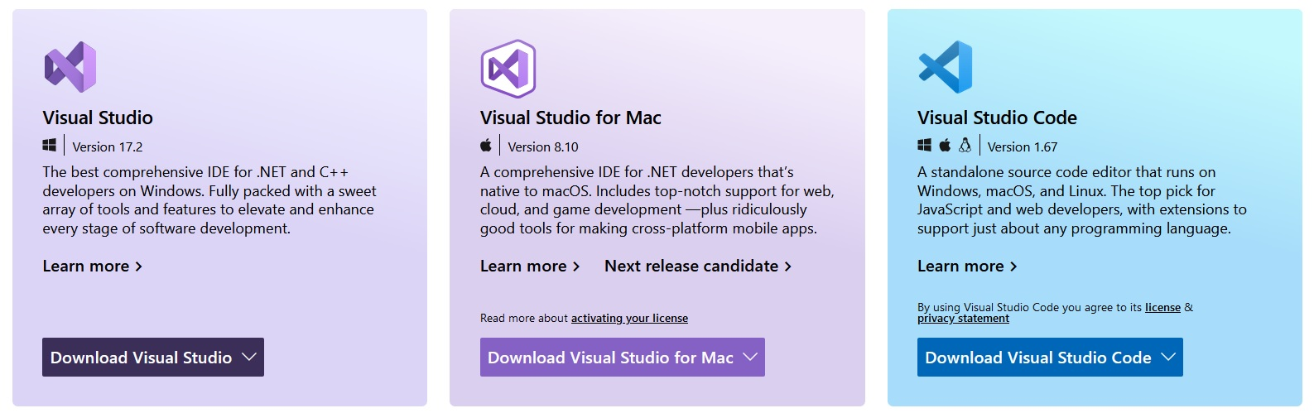
What is an IDE?
IDE - Integrated Development Environment is software that helps us to write/debug/run our source more easily and to create our final programs in better way.
An IDE typically consists of:
Source Code Editor
Local Build Automation
Debugger

Slide 11
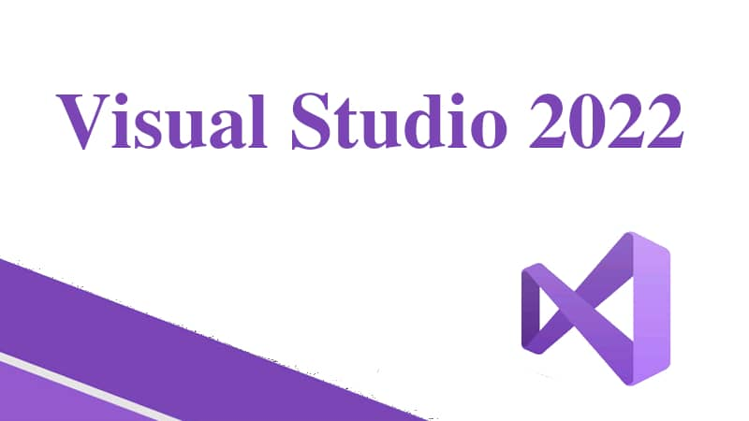
Visual Studio 2022 /installation/

Slide 12
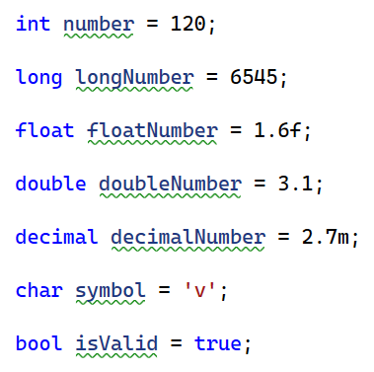
C# variables
Variables are containers for storing of data values.
In C#, there are different types of variables (defined with different keywords).
Examples for variables:
string firstName = “Velizar”; //valid variable name
string 12Test = “test”; //Invalid: cannot starts with number
int my Number = 2; //Invalid: cannot include whitespace
string ln = “Gerasimov”; //Valid, but Not recommended! Instead of that should be lastName because is meaningful.

Slide 13

C# constants
Naming conventions for variables and constants:
For variables: camelCase
For constants: PascalCase
Note: In C# is Not recommended to be used Hungarian Notation.
string strFirstName = “Velizar”;

Slide 14
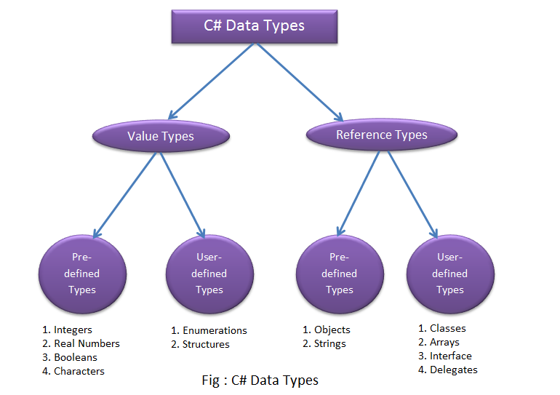
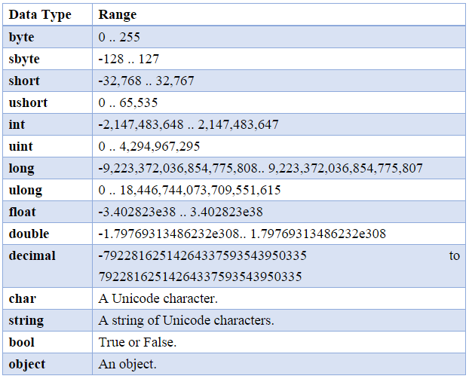
C# data types

Slide 15


C# Console Input/Output

Slide 16
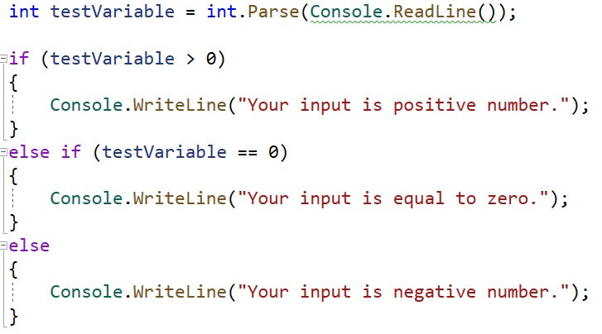
Conditional logic (if/else if/else)

Slide 17
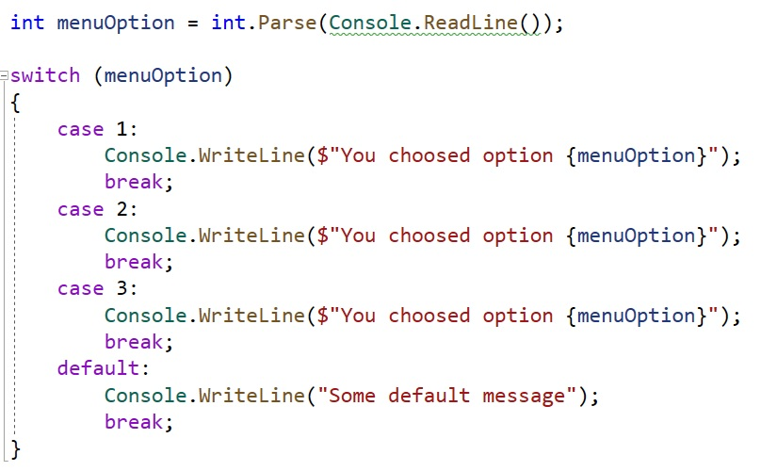
switch/case logic

Slide 18
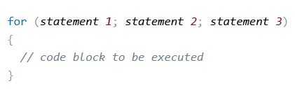
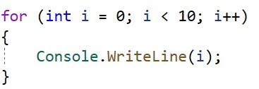
Loops (for loop)
For loop is one of the most used loops in the programming.
It contains three parts:
statement 1 is executed (one time) before the execution of the code block.
statement 2 defines the condition for executing the code block.
statement 3 is executed (every time) after the code block has been executed.

Slide 19
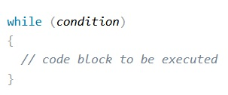
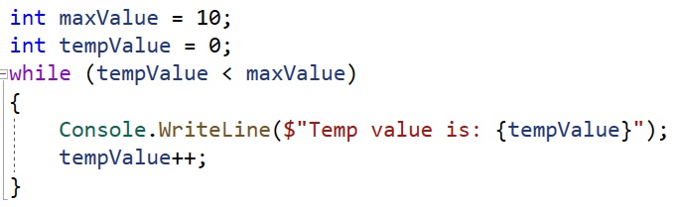
Loops (while loop)
The while loop loops through a block of code as long as a specified condition is True.

Slide 20
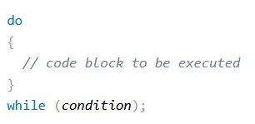
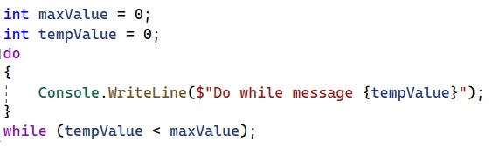
Loops (do/while loop)
The do/while loop is a variant of while loop. This loop will execute the code for sure at least only once, before checking if the condition is True, then it will repeat the loop as long as the condition is true.

Slide 21
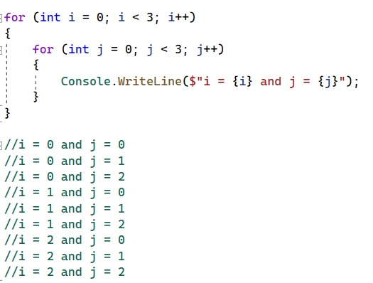
Loops(nested for loops)
It is very important to know that after first iteration of outer loop, the inner loop has to complete. After that again the program goes to outer loop for second iteration, etc.

Slide 22
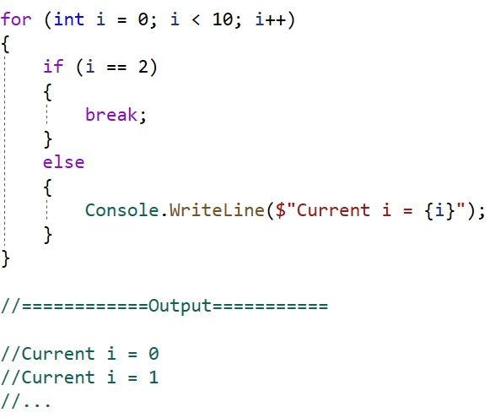
Using of “break”
Break terminates the loop if condition is satisfied.

Slide 23
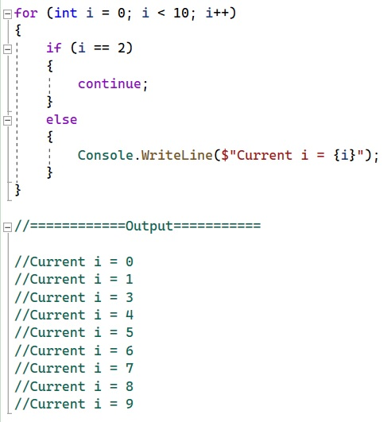
Using of “continue”
Continue just continue to the next loop iteration if the condition is satisfied.

